Slide 1
.
PROJECT REPORT
AIRLINE CUSTOMER SATISFACTION ANALYTICS
SAHIL MUHAMMED ZABIR
AI DRIVEN DATA ANALYTICS
BATCH: DA55

Slide 2
Index
01
Abstract
08
Exploratory Data Analysis
02
Introduction
09
Data Visualization
03
Problem Statement
10
Key Findings and Insights
04
Project Objectives
11
Recommendations
05
Dataset Description
12
Conclusion
06
Tools and Technologies Used
13
Limitations and Future Scope
07
Data Cleaning and Processing
14
References

Slide 3
01 Abstract
This project, titled “Airline Customer Satisfaction Analytics Using Python,” aims to understand passenger satisfaction and the factors related to their travel experience. It analyses passenger details, travel class, onboard services, seat comfort, Wi-Fi, food and drink, and flight delays.
Python libraries such as Pandas, NumPy, Matplotlib and Seaborn are used for data cleaning, analysis and visualization. An interactive scatter plot using Plotly is also included.
The analysis shows that 52.7% of passengers are satisfied. Business Class has the highest satisfaction rate (68.7%), while Eco has the lowest (36.6%). Seat comfort shows the strongest positive correlation with satisfaction (0.329).
Overall, the project identifies patterns in passenger satisfaction and highlights areas related to airline service quality.
52.7%
0.329
passengers satisfied
seat comfort correlation
68.7%
36.6%
Business Class satisfaction
Eco satisfaction

Slide 4
02 Introduction
Airlines operate in a competitive industry where passenger satisfaction is important for customer loyalty and brand reputation. Passengers judge airlines based on factors such as seat comfort, food, onboard services, travel class and flight delays.
This project uses Python to analyse airline passenger data and understand customer satisfaction. It explores customer types, travel classes, service ratings and flight delays.
The project includes data inspection, cleaning, preprocessing, exploratory data analysis (EDA), statistical analysis and visualisation.

Slide 5
03 Problem Statement
Airlines collect passenger and flight data, but it is difficult to understand passenger satisfaction without proper analysis.
The dataset also contains missing values, invalid ratings, inconsistent data and extreme delays.
This project uses Python to clean and analyse the data, identify factors affecting passenger satisfaction, and find useful insights to help improve airline services.

Slide 6
04 Project Objectives
1
Data cleaning and preprocessing: identify and handle missing values, invalid ratings, inconsistent labels, duplicate records and data types.
2
Passenger profile analysis: examine age, customer type and travel-class distributions.
3
Customer satisfaction analysis: calculate the overall satisfaction rate and compare satisfied and dissatisfied passengers.
4
Travel-class comparison: compare satisfaction rates among Business, Eco Plus and Eco passengers.
5
Service quality analysis: examine seat comfort, Wi-Fi service, and food and drink ratings.

Slide 7
04 Project Objectives
6
Flight delay analysis: study departure and arrival delays, create delay categories and compare satisfaction across delay groups.
7
Relationship analysis: use correlation analysis to explore associations between satisfaction and selected numerical variables.
8
Data visualization: create suitable charts to communicate distributions, comparisons and relationships.
9
Insight generation: summarize the most important patterns observed in the dataset.
10
Recommendations: suggest practical areas for further investigation and possible service improvement.

Slide 8
05 Dataset Description
Dataset subject: Airline customer satisfaction and passenger experience.
1,500
10
12
passenger records
raw columns
columns in cleaned dataset (after adding two derived fields)
Dataset size: 1,500 passenger records and 10 raw columns, as reported in the notebook. The cleaned analysis dataset contains 12 columns after adding two derived fields.

Slide 9
05 Dataset Description: Fields and Variables
Field / variable | Description
Raw dataset shape | Passenger satisfaction label: satisfied or dissatisfied
customer_type | Loyal or disloyal customer category
age | Passenger age in years
travel_class | Business, Eco or Eco Plus
flight_distance | Recorded flight distance
seat_comfort | Seat-comfort service rating
wifi_service | In-flight Wi-Fi service rating
food_drink | Food and drink service rating
departure_delay | Departure delay in minutes
arrival_delay | Arrival delay in minutes
delay_category | Derived arrival-delay category: None, Minor, Moderate or Severe

Slide 10
06 Tools and Technologies Used
Python
Google Colab
Pandas
Programming language used for data analysis.
Notebook environment used to run the analysis.
Data loading, cleaning, grouping and tabular summaries.
NumPy
Matplotlib
Seaborn
Numerical operations and data handling.
Chart creation.
Statistical visualizations and correlation heatmaps.

Slide 11
07 Data Cleaning and Processing
Initial inspection
The raw dataset was inspected using the first rows, shape, column names, data types, missing-value counts and descriptive statistics. The notebook reports 1,500 rows and 10 original columns. Initial inspection identified five missing arrival-delay values and zero ratings in some service-rating fields. It also identified inconsistent capitalization in the customer-type category.
Preserving and standardizing the data
Correcting data types
Converting raw, disparate data into a single, uniform format, structure.
The data types were cleaned up to use less memory without losing any information.

Slide 12
Missing Values and Duplicates
Handling missing values
Duplicate records and category labels
There were 5 missing values in the arrival delay column (0.33% of the dataset). These missing values were filled using the median arrival delay of each travel class.
The notebook checks and removes exact duplicate rows. No duplicate rows were found, so the row count remained 1,500. Customer-type text was standardized using title case so inconsistent capitalization does not create separate categories.

Slide 13
Invalid Ratings and Delay Values
Correcting invalid service ratings and delay values
The service ratings should be between 1 and 5, but some values were recorded as 0, which were considered invalid. A total of 114 invalid values were replaced using the median rating for each passenger’s travel class. Negative delay values were also checked, but none were found. Finally, all service ratings were confirmed to be within the valid range of 1 to 5.
1–5
all ratings confirmed within the valid range

Slide 14
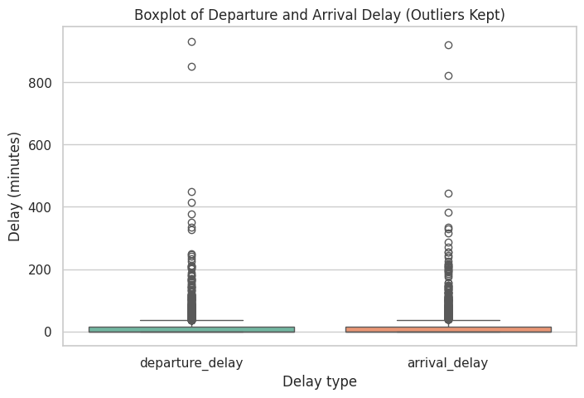
Outlier Detection (IQR Method)
Using the IQR method, 216 departure delays (14.4%) and 213 arrival delays (14.2%) were flagged as outliers. The maximum delays were 933 and 920 minutes.
Figure 1. Boxplot of departure and arrival delay with outliers retained.

Slide 15
Creating Derived Columns
Two analysis-ready columns were added. delay_category groups passengers according to arrival delay: None (0 minutes), Minor (1–15 minutes), Moderate (16–60 minutes) and Severe (more than 60 minutes). satisfaction_binary converts the satisfaction label into 1 (satisfied) or 0 (not satisfied).
Delay category | Arrival-delay definition | Passengers
None | 0 minutes | 812
Minor | 1–15 minutes | 320
Moderate | 16–60 minutes | 245
Severe | More than 60 minutes | 123

Slide 16
Validation and Reproducibility and export
Validation and export
Reproducible pipeline
The notebook validates arrival-delay values, delay-category counts and binary satisfaction values. A final quality report confirms 1,500 rows, 12 columns, zero missing values, zero duplicate rows, zero negative delay values and no ratings outside the valid 1–5 scale.
The updated notebook also wraps the cleaning operations in a single reproducible pipeline that reloads the raw CSV and applies the steps in sequence. The pipeline output has shape (1,500, 12), contains no missing values or duplicate rows, and is identical to the step-by-step df_clean result.

Slide 17
08 Exploratory Data Analysis
Overview
Exploratory Data Analysis was performed to understand the structure and distribution of the cleaned dataset. The notebook uses column summaries, descriptive statistics and categorical counts to examine passenger profiles, satisfaction, service ratings and delay patterns.
Column summary
The cleaned dataset contains 12 columns, each with 1,500 non-null values. The two derived columns are delay_category and satisfaction_binary. Categorical fields contain two to four unique values; service ratings contain five unique values.

Slide 18
08 EDA: Numerical Analysis
Variable | Mean | Median | Minimum | Maximum | Std. dev.
Age | 39.65 | 40 | 7 | 85 | 15.07
Flight distance | 2,032.59 | 1,968.5 | 53 | 5,865 | 1,056.74
Seat comfort rating | 2.92 | 3 | 1 | 5 | 1.29
Wi-Fi service rating | 3.24 | 3 | 1 | 5 | 1.31
Food and drink rating | 2.95 | 3 | 1 | 5 | 1.31
Departure delay (min) | 17.62 | 0 | 0 | 933 | 51.37
Arrival delay (min) | 18.18 | 0 | 0 | 920 | 51.09
The delay means are much higher than the medians, indicating strongly right-skewed delay distributions. Most recorded delays are low or zero, while a small number of very long delays increase the mean. Service ratings sit around the middle of the 1–5 scale.

Slide 19
08 EDA: Categorical Analysis
Category | Count | Percentage
Business class | 731 | 48.7%
Eco class | 651 | 43.4%
Eco Plus | 118 | 7.9%
Loyal customers | 1,210 | 80.7%
Disloyal customers | 290 | 19.3%
Satisfied | 791 | 52.7%
Dissatisfied | 709 | 47.3%
Business is the largest travel-class group. Loyal customers form 80.7% of the records. The satisfaction groups are relatively balanced, with a small majority classified as satisfied. Because the Eco Plus group is smaller, its percentage should be interpreted with more caution.

Slide 20
09 Data Visualization
The updated notebook uses Matplotlib, Seaborn and Plotly to present key comparisons and distributions. The figures below are reproduced from the notebook outputs. The Plotly chart is shown as a static report image; its hover and legend-filtering interactions remain available in the Colab notebook.
7.1 Satisfaction by class
7.2 Age distribution
7.3 Arrival delay by class
7.4 Departure vs arrival
7.5 Overall satisfaction
7.6 Correlation heatmap
7.7 Delay categories
7.8 Interactive scatter

Slide 21
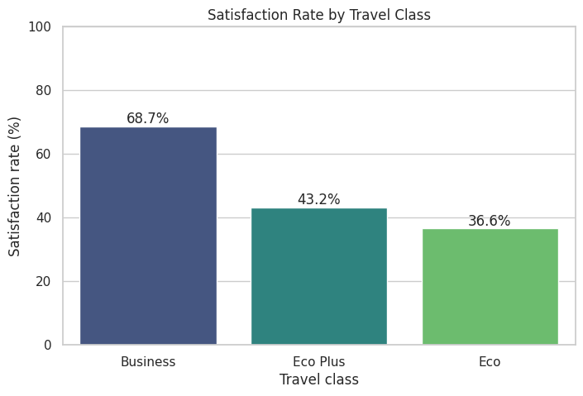
7.1 Satisfaction Rate by Travel Class
Business class has the highest satisfaction rate at 68.7%, followed by Eco Plus at 43.2% and Eco at 36.6%. The class difference is one of the clearest group-level patterns in the data. The Eco Plus figure is based on 118 passengers and should be treated with more caution.
Figure 2. Satisfaction rate by travel class.

Slide 22
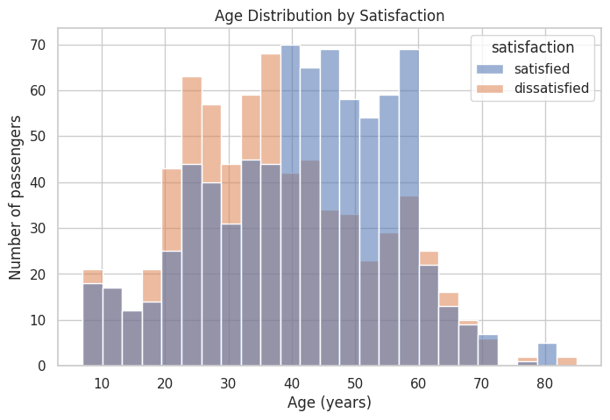
7.2 Age Distribution by Satisfaction
Satisfied passengers are older on average (mean 41.7 years; median 43) than dissatisfied passengers (mean 37.3 years; median 36). The distributions overlap considerably, so age alone does not separate the groups; it is a modest rather than decisive factor.
Figure 3. Age distribution by satisfaction.

Slide 23
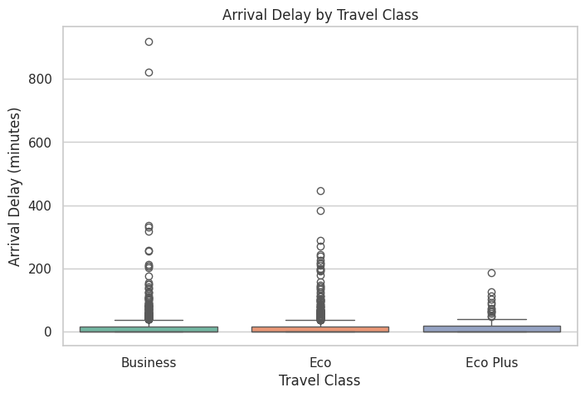
7.3 Arrival Delay by Travel Class
Arrival delay is relatively similar across travel classes. The median is 0 minutes in Business and Eco, and 0.5 minutes in Eco Plus. Mean arrival delays are approximately 18.7 minutes for Business, 18.2 for Eco and 15.0 for Eco Plus. All three classes show a long upper tail of extreme delays; the highest arrival delay (920 minutes) occurs in Business. These differences are relatively small compared with the satisfaction gap between classes.
Figure 4. Arrival delay by travel class.

Slide 24
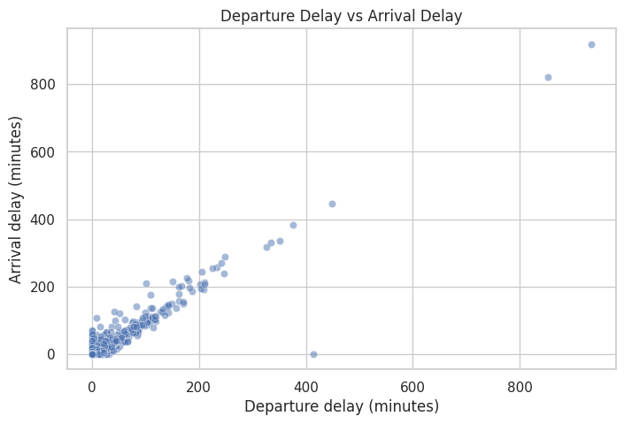
7.4 Departure Delay versus Arrival Delay
Departure and arrival delays are strongly related, with a correlation of 0.953. Points cluster along a diagonal line, indicating that a late departure is usually followed by a late arrival of similar length. The points far from the origin represent extreme delay events retained in the data.
Figure 5. Departure delay versus arrival delay.

Slide 25
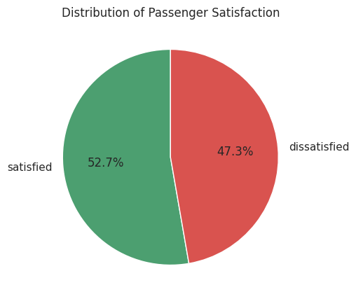
7.5 Overall Satisfaction Distribution
A total of 52.7% of passengers are satisfied and 47.3% are dissatisfied. The classes are nearly balanced, but almost half of all passengers being dissatisfied shows clear room for improvement.
Figure 6. Distribution of passenger satisfaction.

Slide 26
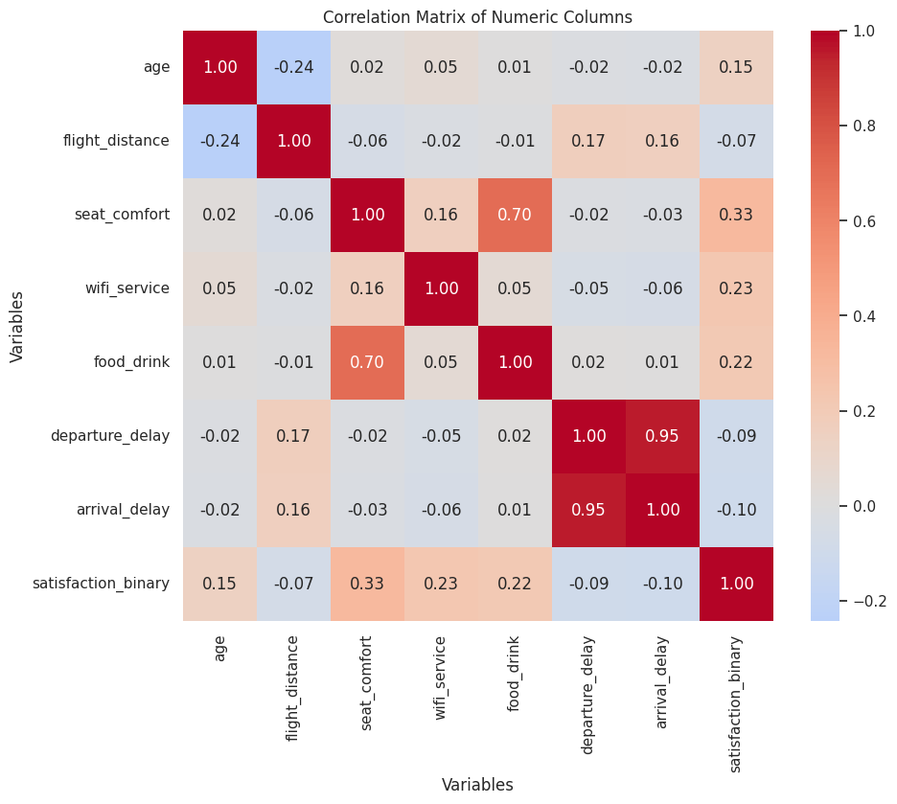
7.6 Correlation Heatmap
Satisfaction has the strongest positive correlation with seat comfort (0.329), followed by Wi-Fi service (0.230), food and drink (0.216) and age (0.145). Delay variables have weak negative correlations with satisfaction: departure delay −0.093 and arrival delay −0.101. All correlations with satisfaction are modest, so no single variable explains satisfaction on its own.
Figure 7. Correlation matrix of numeric columns.

Slide 27
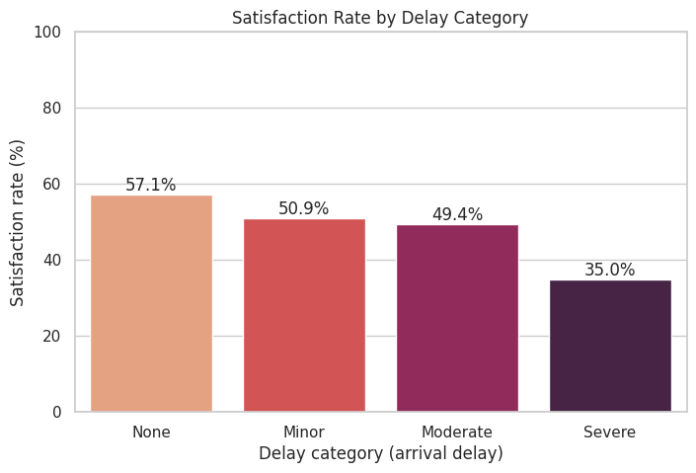
7.7 Satisfaction Rate by Arrival-Delay Category
Satisfaction rates decrease as arrival delays increase: None 57.14%, Minor 50.94%, Moderate 49.39% and Severe 34.96%. The severe-delay group contains 123 passengers. This indicates an association between longer arrival delays and lower passenger satisfaction.
Figure 8. Satisfaction rate by arrival-delay category.

Slide 28
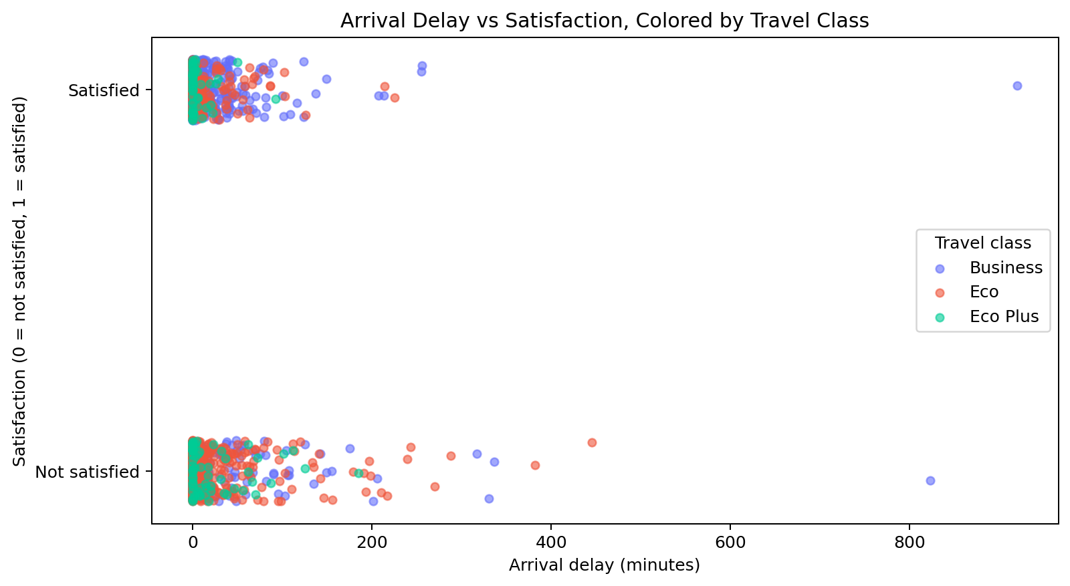
7.8 Bonus: Interactive Plotly Scatter
Each point represents one passenger. A small vertical jitter helps separate the satisfied and not-satisfied rows. Hover information in the notebook shows age, customer type, delay category and satisfaction. The legend can be used to isolate each travel class. Both satisfied and dissatisfied passengers appear across delay levels and classes, reinforcing that delay alone does not determine satisfaction.
Figure 9. Arrival delay versus satisfaction, colored by travel class (static rendering of the notebook’s interactive Plotly chart).

Slide 29
10 Key Findings and Insights
Overall satisfaction: 791 of 1,500 passengers are satisfied, giving an overall satisfaction rate of 52.7%.
Travel class: Business has the highest satisfaction rate (68.7%), Eco Plus is 43.2% and Eco is 36.6%.
Passenger age: satisfied passengers are older on average (41.7 years) than dissatisfied passengers (37.3 years), but age alone does not separate the groups.
Service ratings: Wi-Fi has the highest average rating (3.24/5). Seat comfort has the lowest average rating (2.92/5).
Correlation with satisfaction: Seat comfort has the strongest link with satisfaction. Delays have a weak negative link.

Slide 30
.
Flight delays: departure and arrival delays are strongly related (correlation 0.953). Arrival delay has a weak negative correlation with satisfaction (−0.101).
Delay categories: satisfaction declines from 57.14% for no delay to 34.96% for severe delays. The severe-delay group contains 123 passengers.
Customer type: loyal customers account for 80.7% of the dataset.
Data quality: five missing arrival delays and 114 invalid zero service ratings were corrected; no duplicates or negative delay values remained.
Outliers: IQR analysis flagged 216 departure-delay values and 213 arrival-delay values. They were retained because they may represent genuine operational events.

Slide 31
10 Insight Summary
Measure | Result
Total passengers analyzed | 1,500
Most common travel class | Business (48.7%)
Average passenger age | 39.6 years
Average departure delay | 17.6 minutes
Average arrival delay | 18.2 minutes
Overall satisfaction | 52.7%
Best class by satisfaction | Business (68.7%)
Lowest class by satisfaction | Eco (36.6%)
Highest rated measured service | Wi-Fi (3.24/5)
Lowest rated measured service | Seat comfort (2.92/5)
Satisfaction with no arrival delay | 57.1%
Satisfaction with severe arrival delay | 35.0%
Arrival delay vs satisfaction correlation | −0.101
Final cleaned dataset shape | 1,500 rows × 12 columns

Slide 32
11 Recommendations
Prioritize seat comfort review: it has the lowest average rating and the strongest positive correlation with satisfaction among the measured service variables. Further investigate seat layout, legroom, cushioning and cabin condition.
Review the Eco-class passenger experience: its satisfaction rate is lower than the rates for Business and Eco Plus. Compare service delivery and passenger feedback across classes before selecting improvement actions.
Maintain reliable onboard Wi-Fi: Wi-Fi has the highest average rating of the three measured service items, but it still has room for improvement. Monitor connectivity quality across routes and aircraft.
Monitor food and drink feedback: examine meal quality, availability and consistency across flight duration and travel class.

Slide 33
11 Recommendations (2 of 2)
Improve delay communication and disruption support: severe delays are associated with lower satisfaction. Provide timely updates and clear assistance during disruptions.
Track customer satisfaction regularly: use consistent survey questions and monitor satisfaction by travel class, customer type and service dimension.
Strengthen data quality controls: validate rating ranges, missing delay fields, category labels and duplicate records before analysis.
Use further analysis before operational decisions: the observed correlations are descriptive and should be tested with larger and more representative data before being treated as causal.

Slide 34
12 Conclusion
The project examined airline passenger satisfaction using Python. The analysis identified that Business-class passengers were more satisfied than Eco-class passengers. It also identified that seat comfort had the strongest positive relationship with satisfaction, while longer flight delays were associated with lower satisfaction.
The results demonstrate the importance of examining passenger comfort, service quality, and delays together. Overall, the project achieved its objectives by preparing the dataset, assessing its quality, analysing passenger data, and presenting the results through visualisations. The findings can help airlines focus on passenger comfort, improve service quality, and manage delays better. With further analysis on larger and more recent data, these insights can support better planning and customer experience decisions.

Slide 35
13 Limitations
Dataset coverage: the available sample contains 1,500 records and may not represent every airline, route, aircraft, region or passenger segment. The notebook notes that the project scope document suggests a minimum of 2,000 rows.
Limited variables: the analysis is restricted to the fields included in the dataset. Additional variables such as route, airline, aircraft type, fare, crew service and survey timing could provide a broader view.
No time field: the dataset has no date column, so seasonal or long-term satisfaction trends cannot be analyzed.
Descriptive analysis: correlations and group comparisons show associations, not proof of cause and effect.
Interactive chart delivery: the Plotly visualization is interactive in Colab; this Word report contains a static rendering of that chart.

Slide 36
13 Future Scope
Expand the dataset with more passengers, airlines, routes and time periods.
Add more service-quality variables, including cabin cleanliness, staff interaction, boarding, baggage handling and meal options.
Build an interactive dashboard using Plotly or a business-intelligence tool to allow filtering by class and customer type.
Apply statistical tests and multivariable models to examine which factors remain associated with satisfaction after controlling for other variables.
Explore machine-learning classification only after validating the dataset, avoiding data leakage and evaluating model performance on unseen data.

Slide 37
Data Summary
Description | Final result
Raw dataset shape | 1,500 rows × 10 columns
Final cleaned dataset shape | 1,500 rows × 12 columns
Columns added | delay_category, satisfaction_binary
Missing values (final) | 0; 5 arrival_delay values imputed by class median
Invalid zero ratings corrected | 114 cells: 49 seat comfort, 2 Wi-Fi, 63 food and drink
Duplicate rows (final) | 0 (none found in raw data)
Negative delays | 0
Ratings outside 1 to 5 | 0
Outliers | 216 departure-delay and 213 arrival-delay values flagged by IQR; kept
Output file | airline_clean.csv

Slide 38
14 References
Google
1
Kaggle
2
Entri Elevate – classes
3

